Slide 1


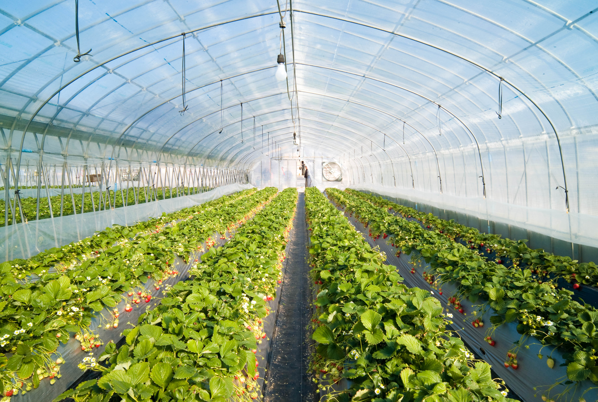
Modern Circesign
GREEN HOUSE MONITORING AND CONTROL
This Photo by Unknown Author is licensed under CC BY-SA

Slide 2
OBJECTIVE :-
Build miniature greenhouse which is equipped with automatic monitoring system.
To control the environmental conditions in “GREEN HOUSE” and to maintain them at optimum levels.

Slide 3

hardware
softwARE
ESP8266
BASIC SHIELD(DHT11,LDR)
SERVO MOTOR
LED’s
RELAY
DC MOTOR
SOIL MOISTURE SENSOR
9V BATTERY
ARDUINO IDE
NODE RED
IBM CLOUD
MIT APP INVENTOR

Slide 4
Functions:-
Lower Temperature: 1 EXHAUST FAN
Increase soil moisture: 1 TAP(SERVO MOTOR)
Increase humidity level: 1 TAP(SERVO MOTOR)
Increase lighting condition: 1 LED

Slide 5
Methodology:
Create a code in arduino software to read the values from different sensors and publish their values to IBM cloud and to get the commands from cloud to
control the hardware devices connected to nodeMCU.
Connect the sensors (DHT11,LDR and SOIL MOISTURE) and output devices (LED,SERVO MOTOR and DC MOTOR) to nodeMCU.
Use node-red service to create an UI which collects values from IBM cloud.
https://trinath.eu-gb.mybluemix.net/ui
Create an app using MIT app inventor which takes values from node-red UI and gives alert messages and commands (Manually).

Slide 6

BLOCK DIAGRAM:
DHT 11
EXHAUST FANFAN
DHT 11
DHT11
ESP8266
WATER SUPPLY
LIGHT
SOIL MOISTURE MOISTURE
IBM CLOUD
NODE-RED(UI) & MIT APP INVENTOR APP INVENTOR

Slide 7
FUTURE SCOPE:-
The performance of the system can be further improved in terms of the operating speed, memory capacity, and instruction cycle period of the microcontroller by using other controllers. The number of channels can be increased to interface more number of sensors which is possible by using advanced versions of microcontrollers.
This system can be connected to communication devices such as modems, cellular phones or satellite terminal to enable the remote collection of recorded data or alarming of certain parameters.

Slide 8
Time bound administration of fertilizers, insecticides and pesticides can be introduced.
A multi-controller system can be developed that will enable a master controller along with its slave controllers to automate multiple greenhouses simultaneously.

Slide 9
CONCLUSION:-
The main advantage of this project is that, all the functions to be performed by the Fan and Sprinkler to control the climatic conditions like temperature, relative humidity and soil moisture levels in the Greenhouse environment are all automated and it does not require any human intervention. This is particularly an important factor because the presence and availability of the human cannot always be trusted on. For important structures like the greenhouses, we need a more dependable and reliable way for its management which is easily achieved by this project.

